Slide 1
Image Super Resolution
By Abhishek Guntaka
0891103

Slide 2
What is Super Resolution?

Slide 3


Low resolution image
High resolution image

Slide 4
How to convert?

Slide 5
ALGORITHM
PRE
PROCESSING
FEATURE
EXTRACTION
NON LINEAR
MAPPING
RECONSTRUCTION

Slide 6
Pre-processing
Original Image
Downsized
Upscaled back to original size

Slide 7
After preprocessing
F
E
A
T
U
R
E
M
A
P
F
E
A
T
U
R
E
M
A
P
Low resolution
Image input
High resolution
Image output
Patch extraction
Non linear mapping
Re-
construction

Slide 8
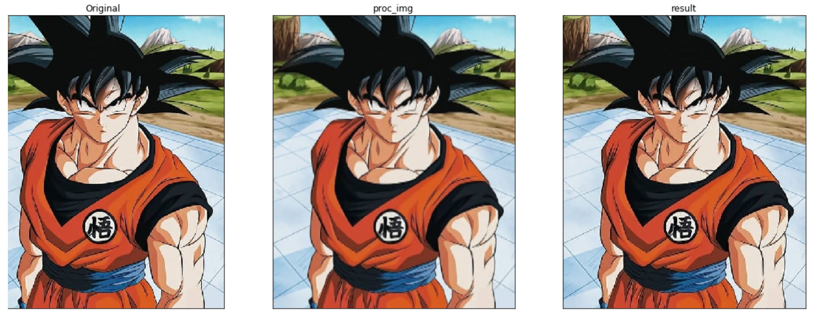
OUTPUT

Slide 9
REFERENCES
https://arxiv.org/abs/1501.00092.

Slide 10
THANK YOU

